Slide 1


Chapter 6
Transform-and-Conquer
Copyright © 2007 Pearson Addison-Wesley. All rights reserved.

Slide 2
Transform and Conquer
Transform & Conquer is a general algorithm design technique which works in two stages.
STAGE 1: (Transformation stage): The problem’s instance is modified, more amenable to solution
STAGE 2: (Conquering stage): The transformed problem is solved
This group of techniques solves a problem by a transformation
To a simpler/more convenient instance of the same problem (instance simplification) ex: list pre-sorting, AVL trees.
To a different representation of the same instance (representation change) ex: 2-3 trees, heaps and heapsort.
To a different problem for which an algorithm is already available (problem reduction) ex: reduction to graph problems.

Slide 3
Heaps and Heapsort
Definition A heap is a binary tree with keys at its nodes (one key per node) such that:
It is essentially complete, i.e., all its levels are full except possibly the last level, where only some rightmost keys may be missing
The key at each node is ≥ keys at its children (this is called a max-heap/ Parental dominance requirement)

Slide 4
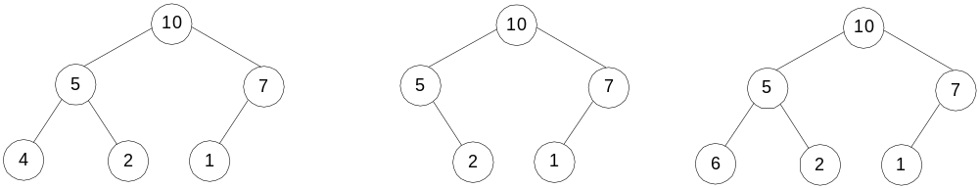
Illustration of the heap’s definition
a heap
not a heap
not a heap
Note: Heap’s elements are ordered top down (along any path
down from its root), but they are not ordered left to right

Slide 5
Some Important Properties of a Heap
Given n, there exists a unique binary tree with n nodes that
is essentially complete, with h = ⎣log₂ n⎦
The root contains the largest key
The subtree rooted at any node of a heap is also a heap
A heap can be represented as an array

Slide 6
Heap’s Array Representation
Store heap’s elements in an array (whose elements indexed, for convenience, 1 to n) in top-down left-to-right order
Example:
Left child of node j is at 2j
Right child of node j is at 2j+1
Parent of node j is at ⎣j/2⎦
Parental nodes are represented in the first ⎣n/2⎦ locations
9
1 2 3 4 5 6
5
3
9 5 3 1 4 2
1
4
2

Slide 7
Heap Construction (bottom-up)
Step 0: Initialize the structure with keys in the order given
Step 1: Starting with the last (rightmost) parental node, fix the heap rooted at it, if it doesn’t satisfy the heap condition: keep exchanging it with its larger child until the heap condition holds
Step 2: Repeat Step 1 for the preceding parental node

Slide 8
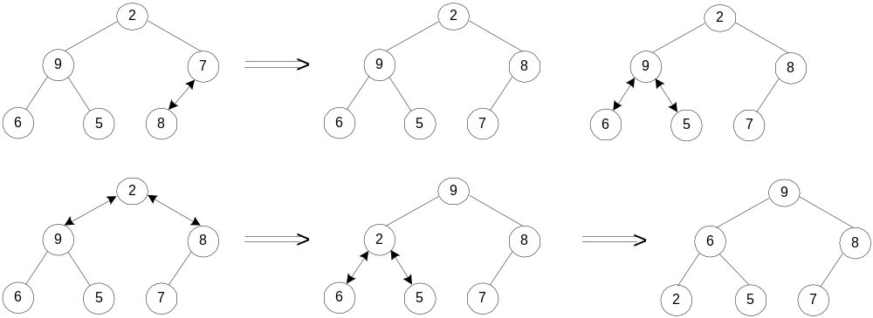
Example of Heap Construction
Construct a heap for the list 2, 9, 7, 6, 5, 8

Slide 9
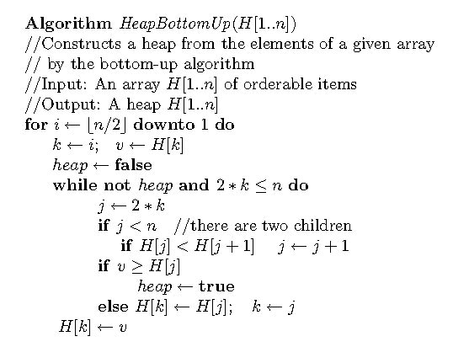
Pseudopodia of bottom-up heap construction

Slide 10
Heapsort
Stage 1: Construct a heap for a given list of n keys
Stage 2: Repeat operation of root removal n-1 times:
    Exchange keys in the root and in the last (rightmost) leaf
    Decrease heap size by 1
    If necessary, swap new root with larger child until the heap condition holds

Slide 11
Example of Sorting by Heapsort
Sort the list 2, 9, 7, 6, 5, 8 by heapsort
Stage 1 (heap construction) Stage 2 (root/max removal)
2 9 7 6 5 8 9 6 8 2 5 7
2 9 8 6 5 7 7 6 8 2 5 | 9
2 9 8 6 5 7 8 6 7 2 5 | 9
9 2 8 6 5 7 5 6 7 2 | 8 9
9 6 8 2 5 7 7 6 5 2 | 8 9
2 6 5 | 7 8 9
6 2 5 | 7 8 9
5 2 | 6 7 8 9
5 2 | 6 7 8 9
2 | 5 6 7 8 9

Slide 12
Analysis of Heapsort
Stage 1: Build heap for a given list of n keys
worst-case
C(n) =
Stage 2: Repeat operation of root removal n-1 times (fix heap)
worst-case
C(n) =
Both worst-case and average-case efficiency: Θ(nlogn)
In-place: yes
Stability: no (e.g., 1 1)
h-1
Σ
2(h-i) 2^{i} = 2 ( n – log₂(n + 1)) ∈ Θ(n)
i=0
# nodes at level i
n-1
Σ
2log₂ i ∈ Θ(nlogn)
i=1

Slide 13
Priority Queue
A priority queue is the ADT of a set of elements with
numerical priorities with the following operations:
  find element with highest priority
  delete element with highest priority
  insert (new) element with assigned priority (see below)
Heap is a very efficient way for implementing priority queues
A min-heap can also be used to handle priority queue in which
highest priority = smallest number

Slide 14
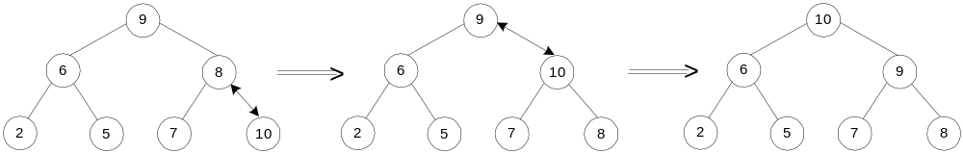
Insertion of a New Element into a Heap
Insert the new element at last position in heap.
Compare it with its parent and, if it violates heap condition,
exchange them
Continue comparing the new element with nodes up the tree until the heap condition is satisfied
Example: Insert key 10
Efficiency: O(log n)

Slide 15
Horner’s Rule For Polynomial Evaluation
Given a polynomial of degree n
p(x) = a_{n}x^{n} + a_{n-1}x^{n-1} + … + a₁x + a₀
and a specific value of x, find the value of p at that point.
Two brute-force algorithms:
p ← 0 p ← a₀; power ← 1
for i ← n downto 0 do for i ← 1 to n do
power ← 1 power ← power * x
for j ← 1 to i do p ← p + a_{i} * power
power ← power * x return p
p ← p + a_{i} * power
return p

Slide 16
Horner’s Rule
Example: p(x) = 2x⁴ - x³ + 3x² + x - 5
= x(2x³ - x² + 3x + 1) - 5
= x(x(2x² - x + 3) + 1) - 5
= x(x(x(2x - 1) + 3) + 1) - 5
Substitution into the last formula leads to a faster algorithm
Same sequence of computations are obtained by simply
arranging the coefficient in a table and proceeding as follows:
coefficients 2 -1 3 1 -5
x=3
2 3*2+(-1)=5 3*5+3=18 3*18+1=55 3*55+(-5)=160

Slide 17
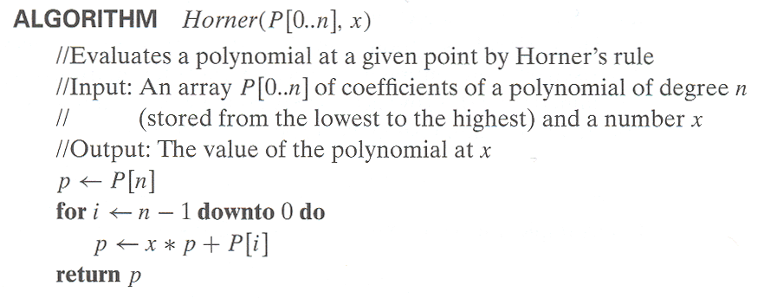
Horner’s Rule pseudocode
Efficiency of Horner’s Rule: # multiplications = # additions = n
Synthetic division of p(x) by (x-x₀)
Example: Let p(x) = 2x⁴ - x³ + 3x² + x - 5. Find p(x):(x-3)
2x^3 + 5x^2 + 18x + 55

Slide 18
Computing a^{n} (revisited)
Left-to-right binary exponentiation
Initialize product accumulator by 1.
Scan n’s binary expansion from left to right and do the following:
If the current binary digit is 0, square the accumulator (S);
if the binary digit is 1, square the accumulator and multiply it by a (SM).
Example: Compute a¹³. Here, n = 13 = 1101₂.
binary rep. of 13: 1 1 0 1
SM SM S SM
accumulator: 1 1²*a=a a²*a = a³ (a³)² = a⁶ (a⁶)²*a= a¹³ (computed left-to-right)
Efficiency: (b-1) ≤ M(n) ≤ 2(b-1) where b = ⎣log₂ n⎦ + 1

Slide 19
Computing a^{n} (cont.)
Right-to-left binary exponentiation
Scan n’s binary expansion from right to left and compute a^{n} as the product of terms a^{2 i} corresponding to 1’s in this expansion.
Example Compute a¹³ by the right-to-left binary exponentiation. Here, n = 13 = 1101₂.
1 1 0 1
a⁸ a⁴ a² a : a^{2 i} terms
a⁸ * a⁴ * a : product (computed right-to-left)
Efficiency: same as that of left-to-right binary exponentiation

